Slide 1
Hallo Doc
Presented By : Dushyantpuri Goswami
Enrollment No.: 200200107023

Slide 2
INTRODUCTION_______________________________________________________
The HalloDoc platform, also known as a Health-care website.
This platform will offer online Doctors consultation and Diagnostics services.
It offers a user-friendly interface that simplifies various tasks for doctors.
They can conveniently access patient records, efficiently manage appointments, and securely communicate with their patients.
Additionally, patients can utilize the website to request care for themselves or on behalf of others.

Slide 3
TECHNOLOGY ________________________________________________________
HTML
CSS
JavaScript
ASP .NET 7.0 CORE MVC (Model – View – Controller)

Slide 4
WORK DONE__ ________________________________________________________
Week 7 (19 Feb – 23 Feb , 2024)
Admin Dashboard
View Case

Slide 5
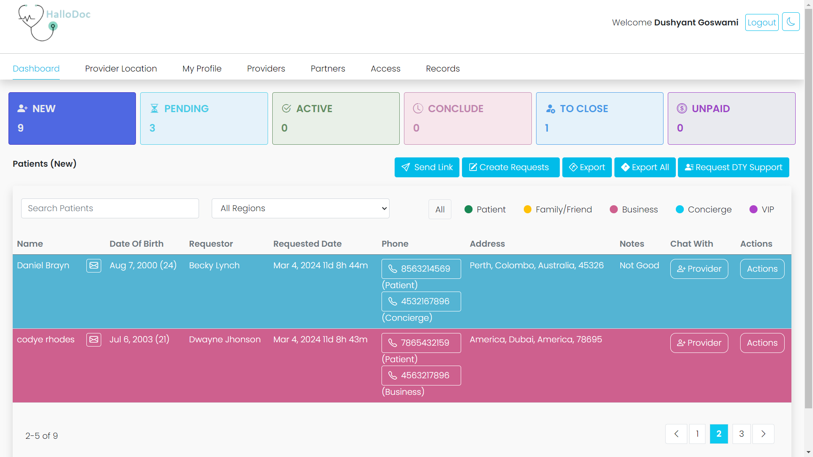
Admin Dashboard

Slide 6
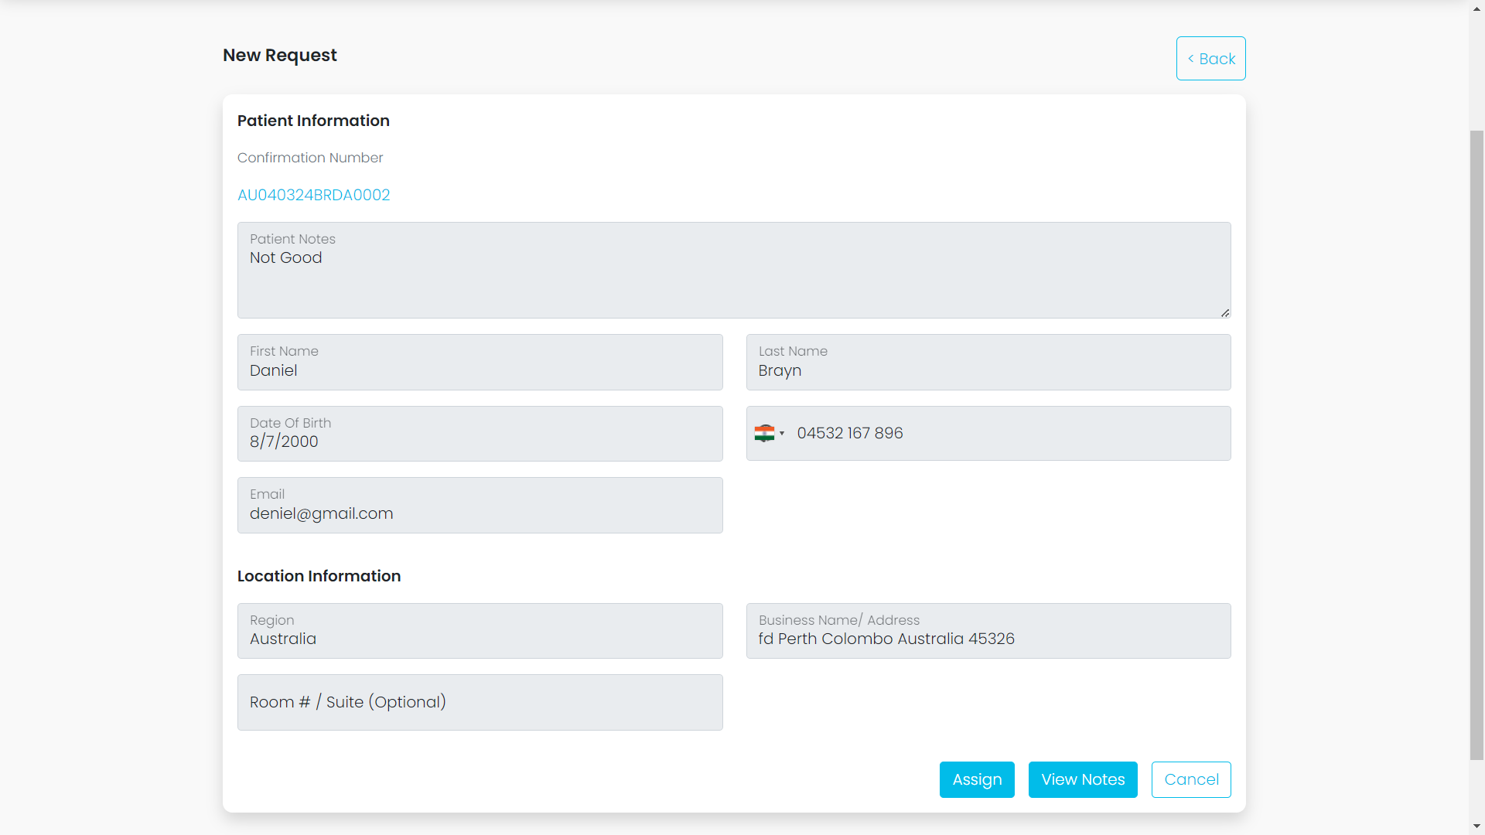
View Case

Slide 7
Week 8 (26 Feb – 01 March , 2024)
View Notes
Cancel Case
Assign Case
Block Case

Slide 8
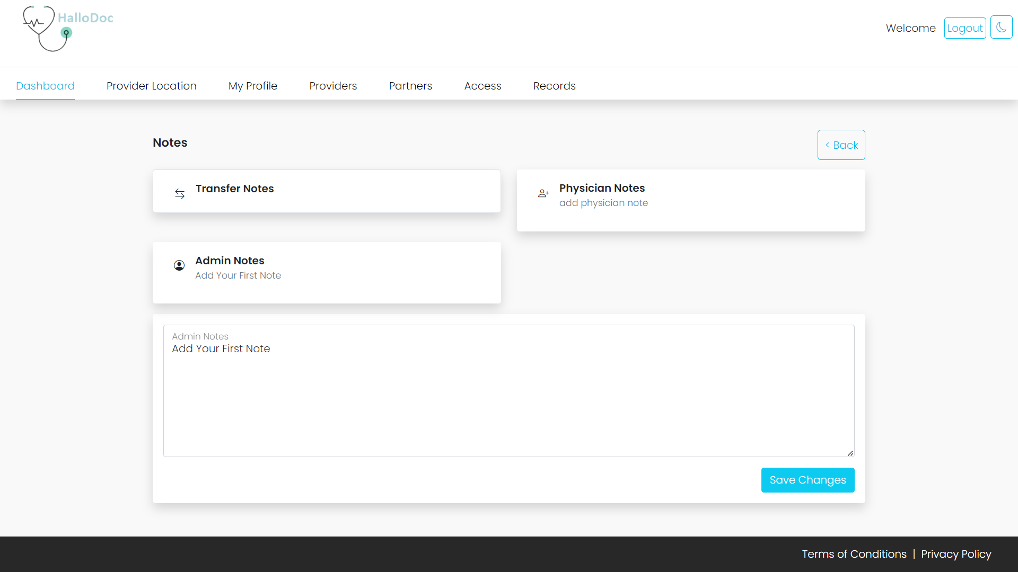
View Notes

Slide 9
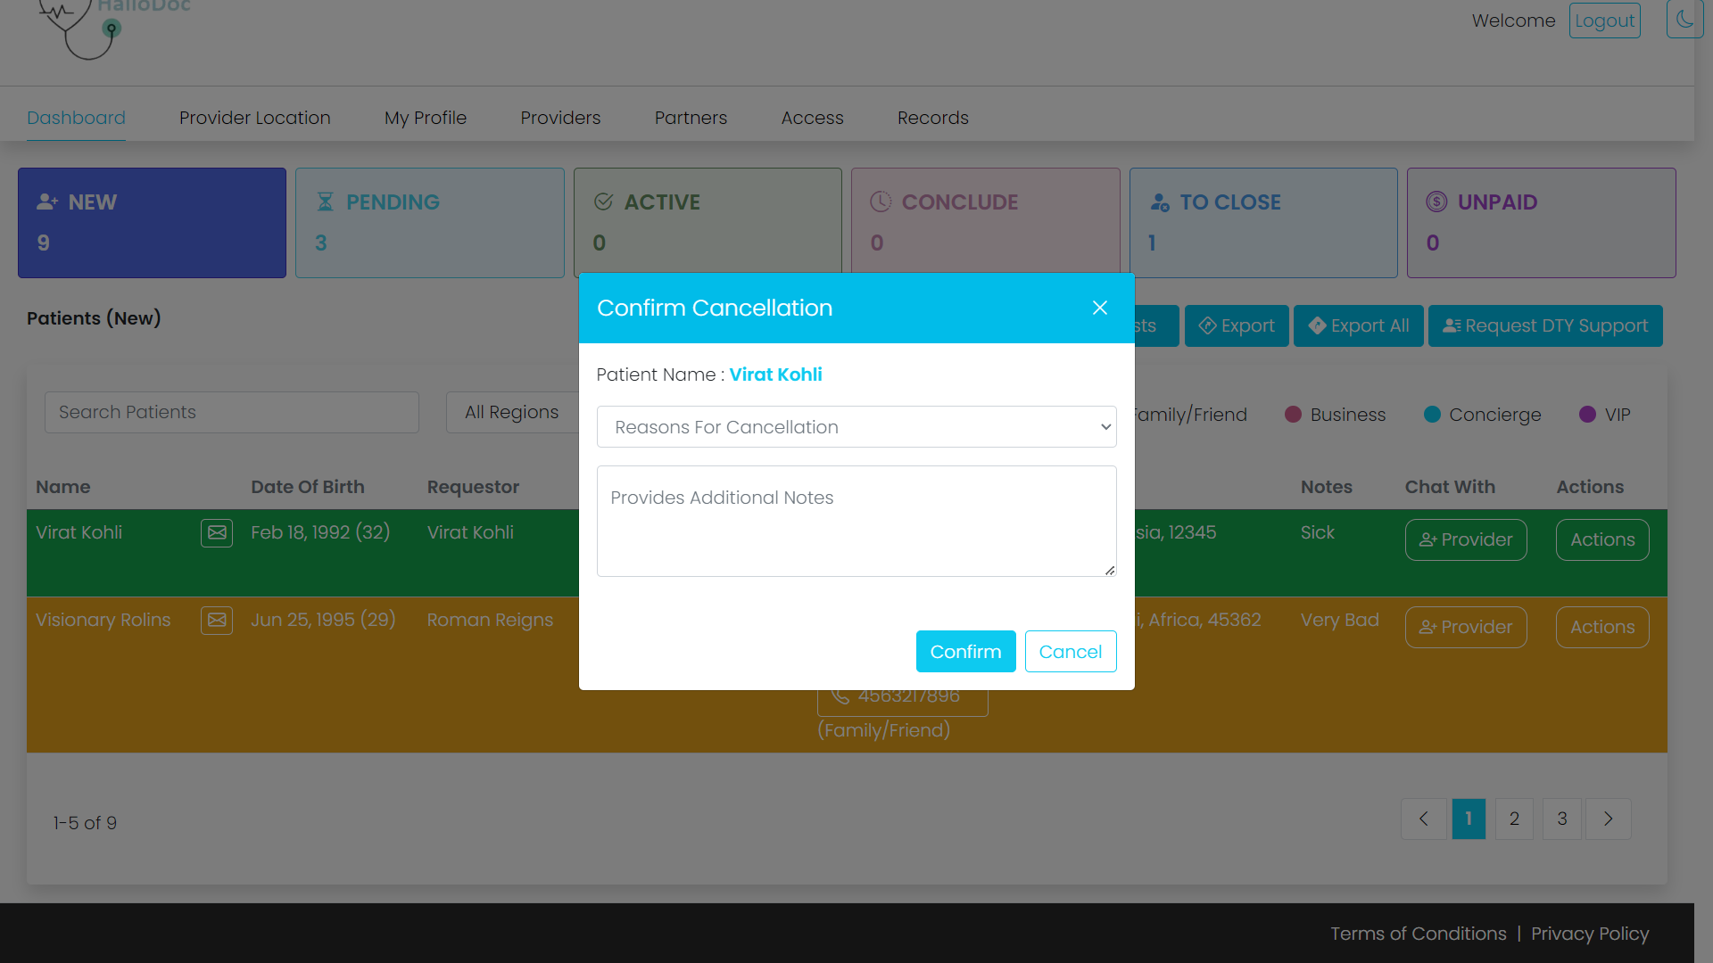
Cancel Case

Slide 10
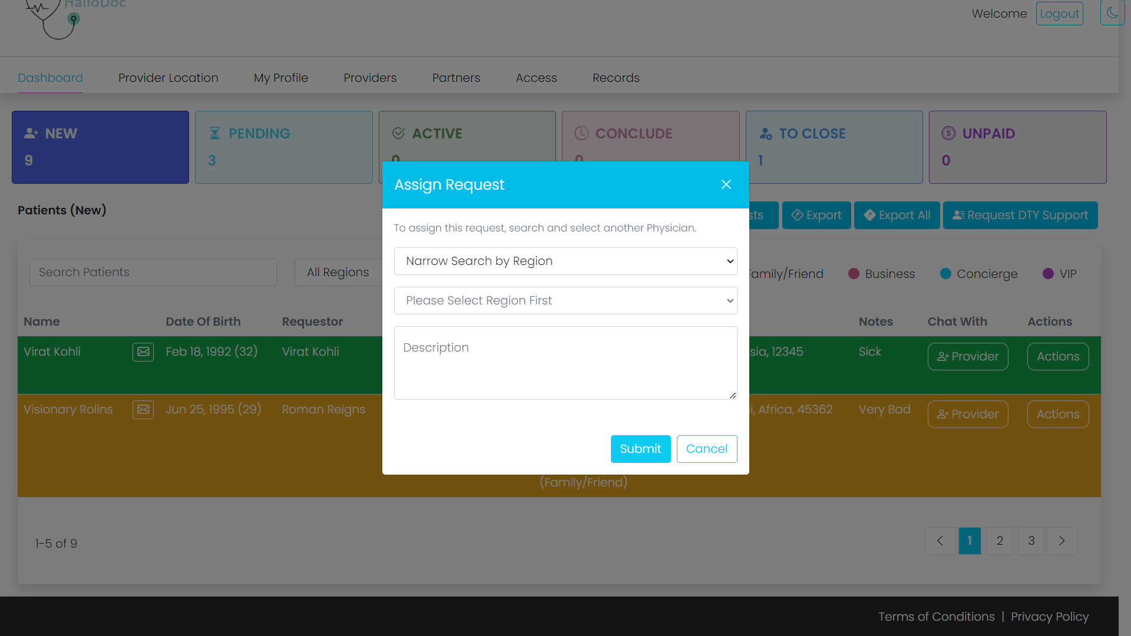
Assign Case

Slide 11
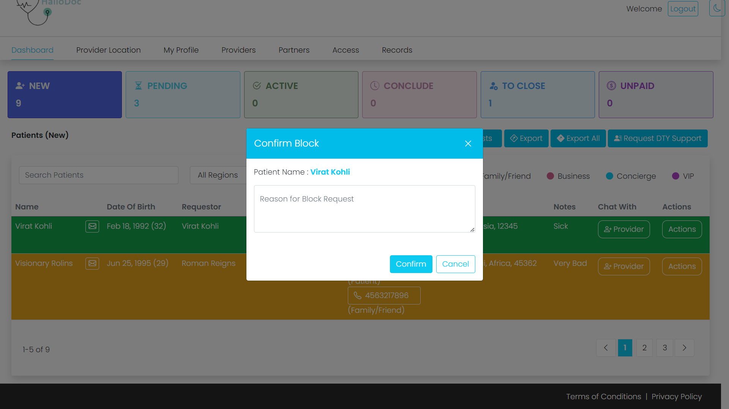
Block Case

Slide 12
Week 9 (04 March – 08 March 2024)
View Upload
JWT Authentication & Authorization
Send Order
Transfer Case

Slide 13
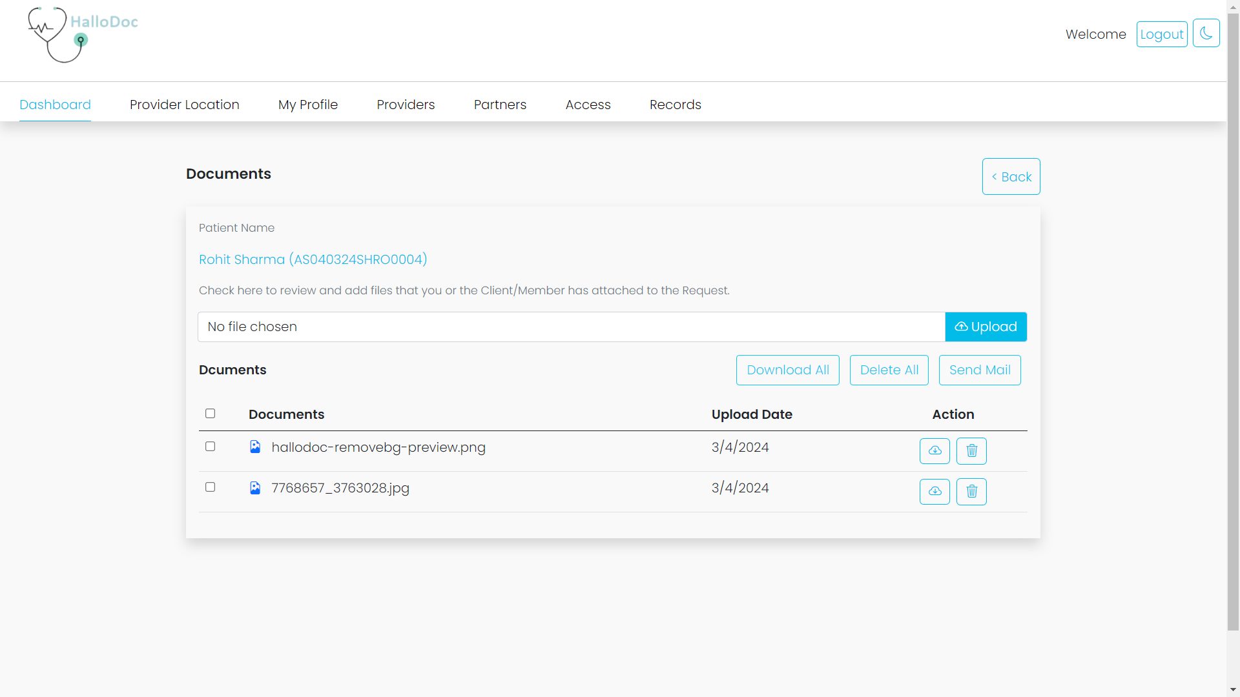
View Upload

Slide 14
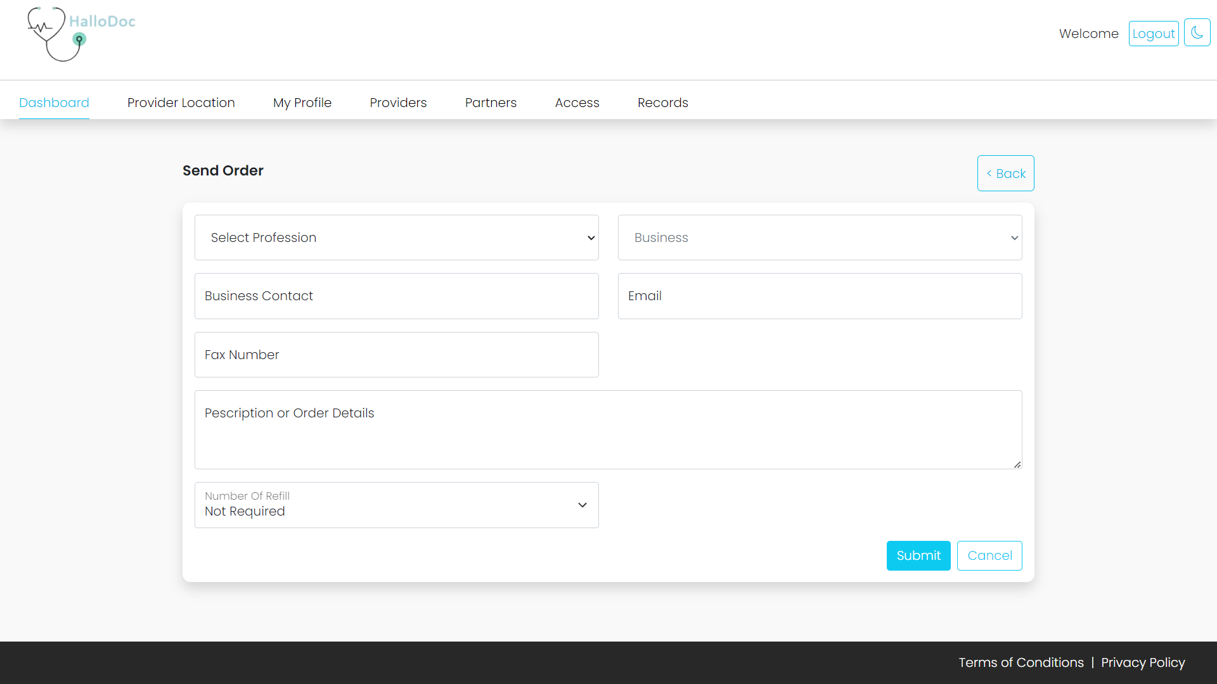
Send Order

Slide 15
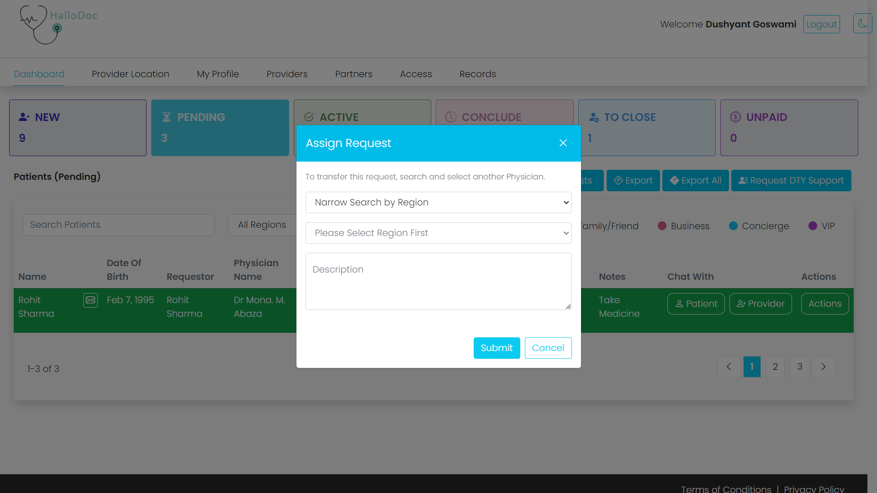
Transfer Case

Slide 16
Week 10 (11 March – 15 March 2024)
Clear Case
Send Agreement
Encounter Form

Slide 17
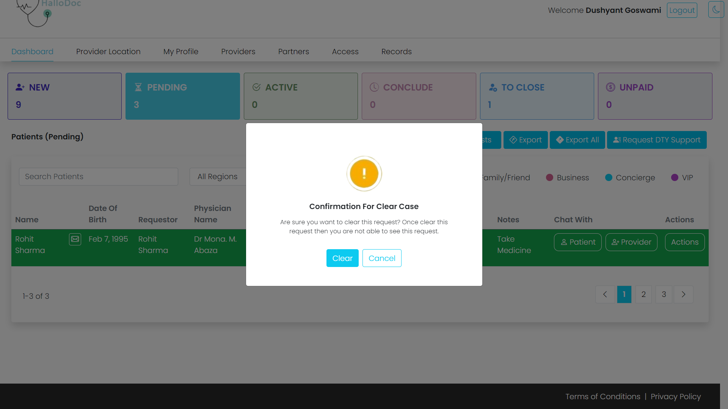
Clear Case

Slide 18
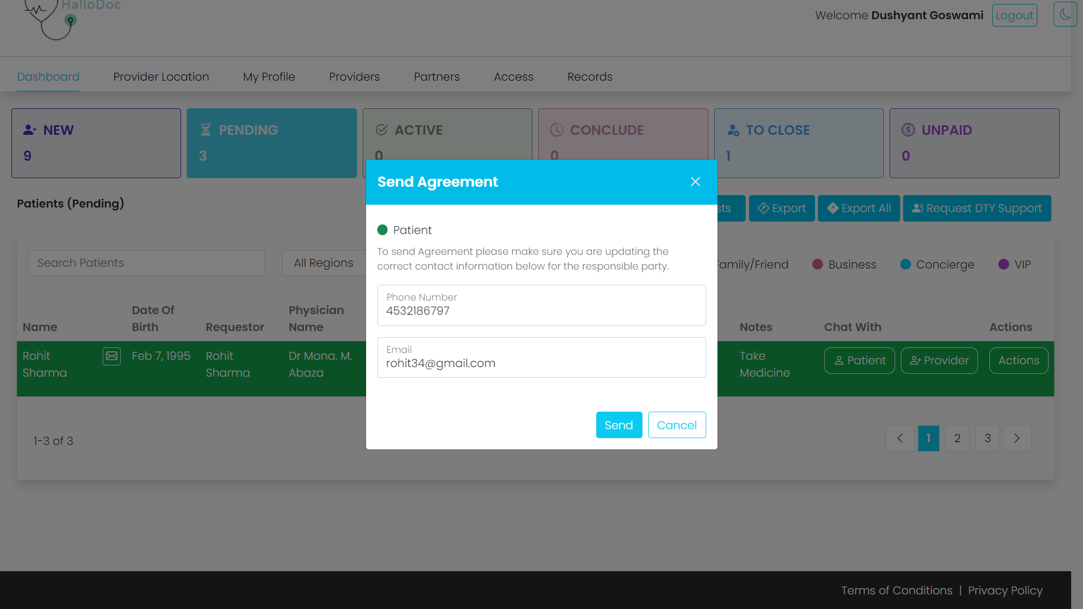
Send Agreement

Slide 19
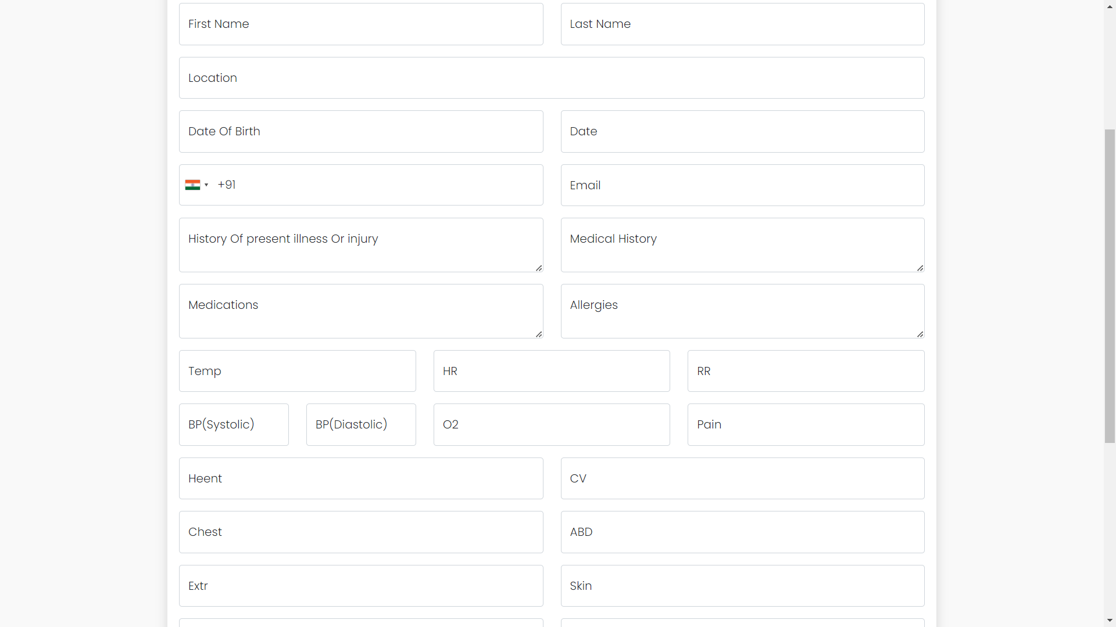
Encounter Form

Slide 20
Thank You

